Slide 1
Final Assignment

Slide 2
content

Slide 3
BUSINESS NEED
CRISA , an Asian market research agency wants to segment the market based on purchase behavior and basis of purchase, to allocate promotion budgets effectively.

Slide 4
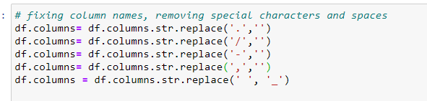
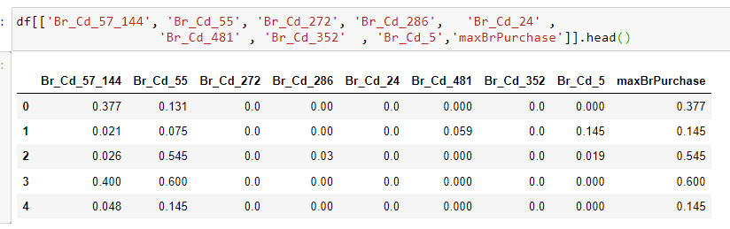
Explore, clean, and preprocess the data
Steps:
1- Rename column names , removing punctuation, spaces and special character
2- Create MaxbrandPurchase variable – indicating the maximum % purchase among the brands (except others)

Slide 5
Explore, clean, and preprocess the data
Steps:
3- Separated non demographics dataset
4- Purchase Behviour features includes 'No_of_Brands', 'Brand_Runs', 'Total_Volume',
'No_of__Trans', 'Value', 'Trans__Brand_Runs', 'VolTran', 'Avg_Price_','maxBrPurchase','Others_999’
5- Standardized numerical columns

Slide 6
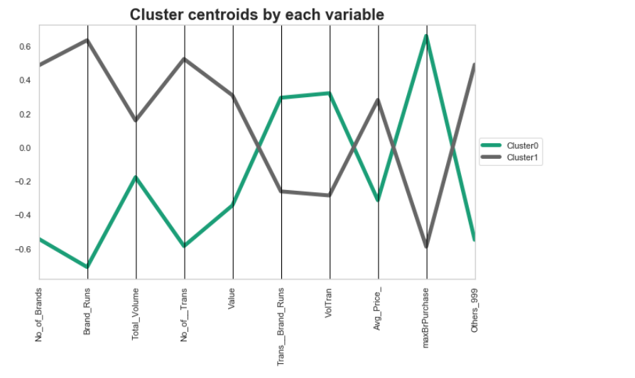
PERFORM KMEANS with k=2
Cluster 0 characterized by less no of brands, but high % of Brand purchase, and low % of other brands. (Brand loyal segment).
Cluster 1 characterized by high total volume by others brands (not brand loyal segment)
Max % of brand purchase and No of Brands does good job at segmenting these households

Slide 7
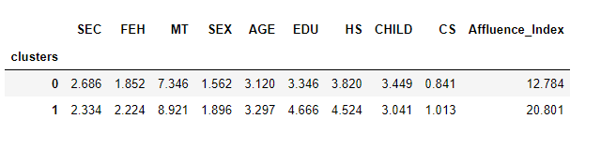
PERFORM KMEANS with k=2
Demographic information by each cluster:
cluster 0 (brand loyal) are mostly with moderately lower socioeconomic class, and average lower education level, with lower Affluence index.
cluster 1 (non brand loyal) with moderately higher socioeconomic class, and higher education level, with high Affluence index

Slide 8
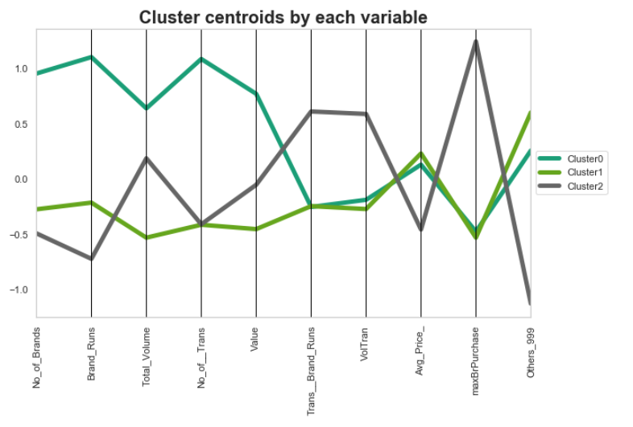
PERFORM KMEANS with k=3
Cluster 0 represent high no of brands purchases with more transaction, but slightly high purchases for other brands. These must be moderately (not very) loyal customers.
Cluster 1 represents non loyal customers, with high other brand purchases, with avg purchase price higher than rest of the clusters.
Cluster 2 represents brand loyal customers, with average purchase price lower(can be a promotion impact, will have to inspect with basis of purchase variables), and volume of transactions being higher, with lower no of brands purchased lower.

Slide 9
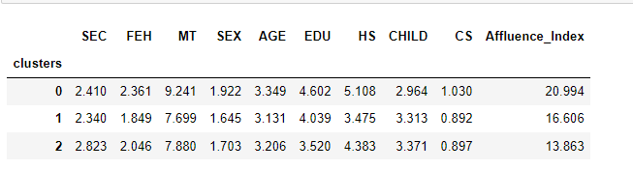
PERFORM KMEANS with k=4
Demographic information by each cluster:
Cluster 0 represents majority non vegetarian women, with moderately high education level, and average 5 household members.
Cluster 2 represents majority lower socioeconomic class with lower education level

Slide 10
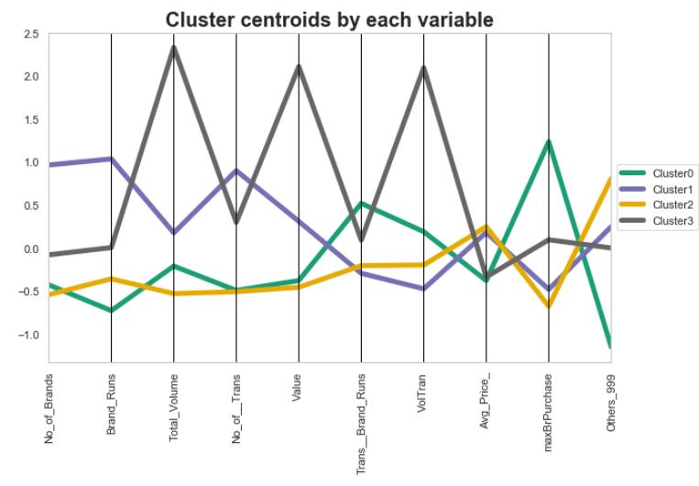
PERFORM KMEANS with k=4
Cluster 0 characterizes brand loyal customers, with high transaction per brand.
Cluster 1 and Cluster 2 represents not brand loyal customers, with cluster 2 being high brand runs (consecutive transactions) and high number of brands purchased.
Cluster 3 is fairly loyal customers, with less number of brands purchaed, but with high total volume

Slide 11
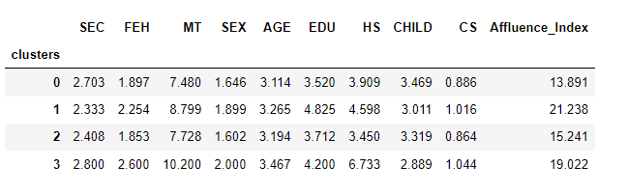
PERFORM KMEANS with k=4
Demographic information by each cluster:
Cluster 0 characterizes lower socioeconomic class with majority vegetarian, who eats egg, lower education level and low affluency.
Cluster 3 represents lower socioeconomic class , with majority non vegetarian female, native language 10 , and average household member 6 or more.

Slide 12
Explore, clean, and preprocess the data
Steps:
Basis of purchase includes 'Pur_Vol_No_Promo__%', 'Pur_Vol_Promo_6_%', 'Pur_Vol_Other_Promo_%','Pr_Cat_1', 'Pr_Cat_2', 'Pr_Cat_3', 'Pr_Cat_4', 'PropCat_5', 'PropCat_6', 'PropCat_7', 'PropCat_8', 'PropCat_9', 'PropCat_10', 'PropCat_11', 'PropCat_12', 'PropCat_13', 'PropCat_14', 'PropCat_15’
Standardized basis of purchase data frame.

Slide 13

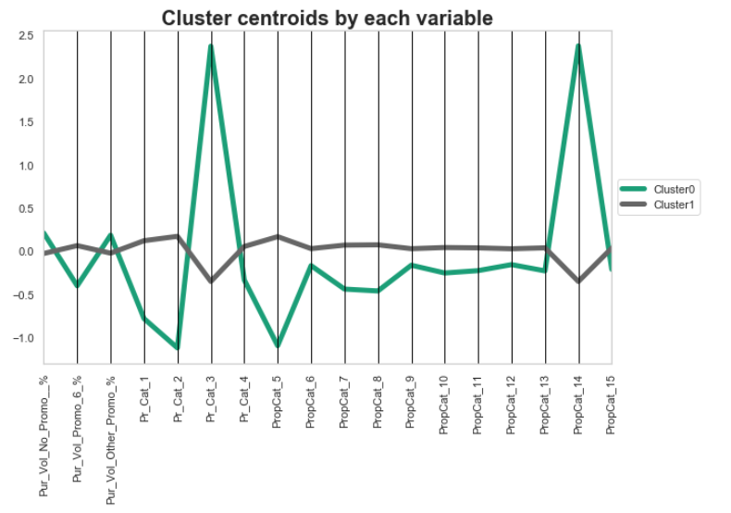
PERFORM KMEANS with k=2 on basis of purchase
Cluster 0 has 78 with low within squared error, while cluster 1 has 522 members with very high error.
Cluster 0 represents those who are not price conscious, and generally purchase more even if there is no promotion with price category 3 and proposition category 14
Cluster 1 characterizes those househlds which are price conscious, and purchases when there is promotion (6% or other)

Slide 14
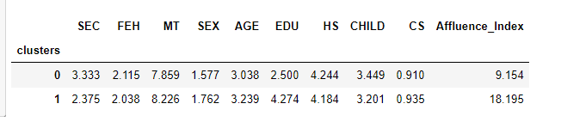
PERFORM KMEANS with k=2
Demographic information by each cluster:
Cluster 0 represents lower socioeconomic class with low affluency and low education level.
Cluster 1 represents high socioeconomica class, with average to high education level

Slide 15

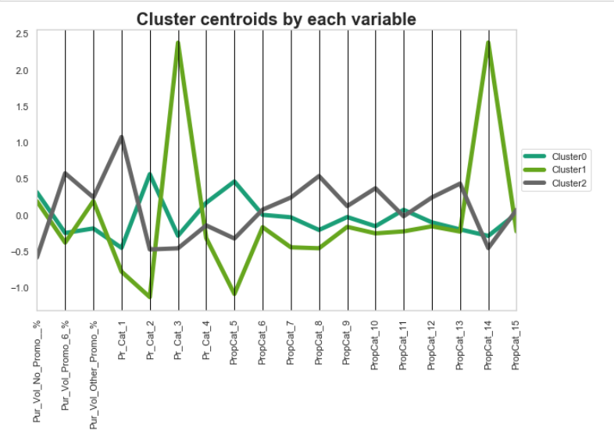
PERFORM KMEANS with k=3 on basis of purchase
Cluster 1 has lower number of samples, with low within the cluster squared error. While for Cluster 0 and 2, the error is very high.
Cluster 0 are not price conscious, they purchases even if there is no promotion, price category 2, and proposition category 5.
Cluster 1 represents those who purchases with other promotion offer, from price category 3, and proposition category 14
Cluster 2 represent price conscious customer, they purchase with promotion, and proposition category 8.

Slide 16
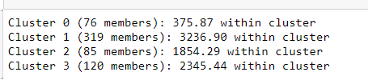
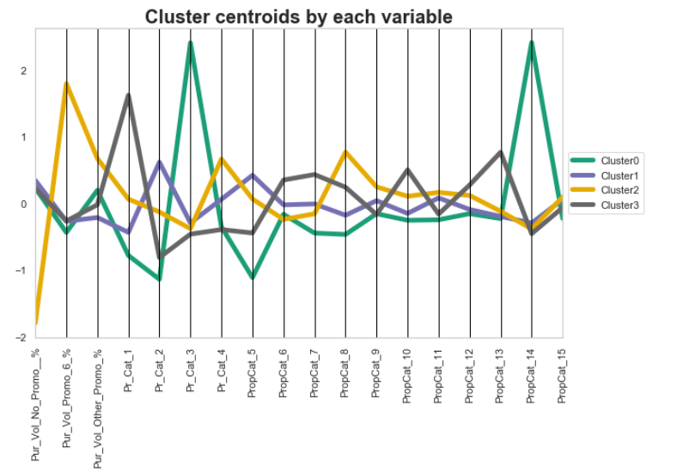
PERFORM KMEANS with k=4 on basis of purchase
Cluster 0 and 2 have very less number of samples, Cluster 1 has high number of samples, Cluster 3 has fairly low number of samples
Cluster 0 represents those households who purchases under no promotions or other promotions.
Cluster 1 characterizes no promotion purchasers from price category 2 and proposition category 5
Cluster 2 are one purchases mostly when there's 6% promotion, on price category 4 and proposition category 8.
Cluster 3 are those purchase moslty when no promotion, and price category 1.

Slide 17
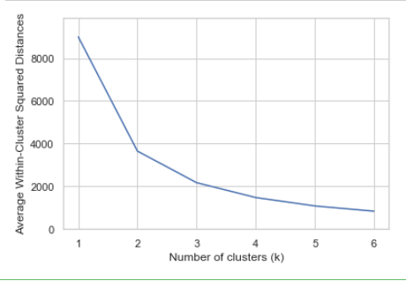
Identifying optimal value of K
Optimal value of K can be 3, or 4.
Adding more cluster doesn’t improve cluster homogeneity much.

Slide 18
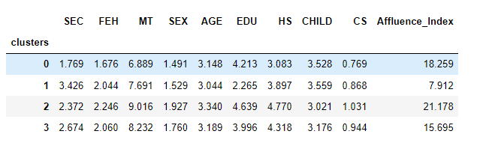
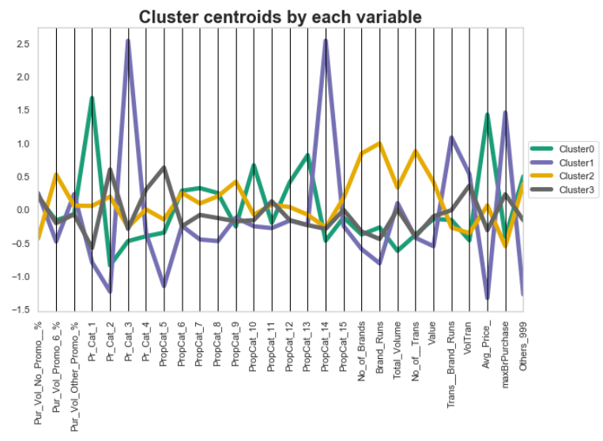
PERFORM KMEANS with OPTIMAL k=4,
Used both basis of purchase and purchase behavior features
Demographic information by each cluster:
Cluster 0: Disloyal price unconscious customer, buy mostly from price category 1, and proposition 10 and 13. (Less volume but high avg price).High socio-economic class with fairly high affluence index.
Cluster 1: Extremely loyal, buys with other promotion or no promotion, from price category 3 and proposition category 14. (High total brand run but low avg price). Lower socioeconomic class with low education level and lowest affluence index
Cluster 2: Disloyal, buys with 6% promotion, high number of brands and transactions. Average socioeconomic class with large house, with highest affluency
Cluster 3: fairly loyal, price unconscious, buys from price category 2 and proposition category 5. High volume of transaction. Low socioeconomic class, with average education level, having large family

Slide 19
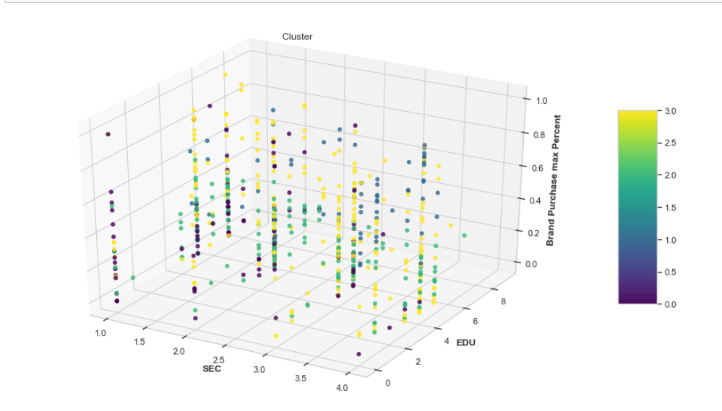
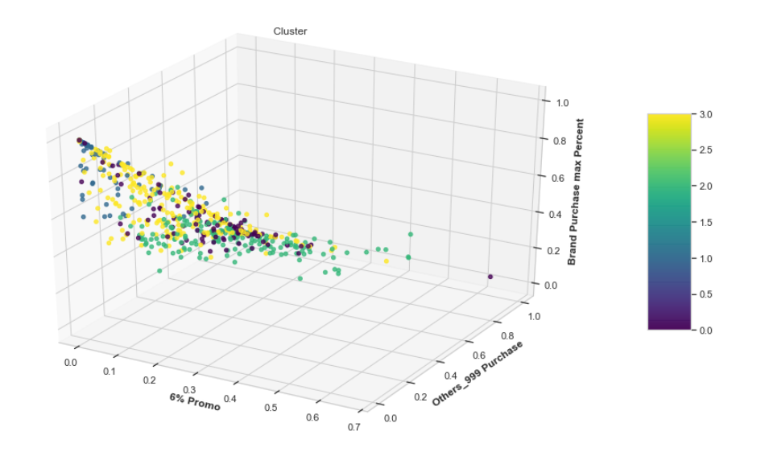
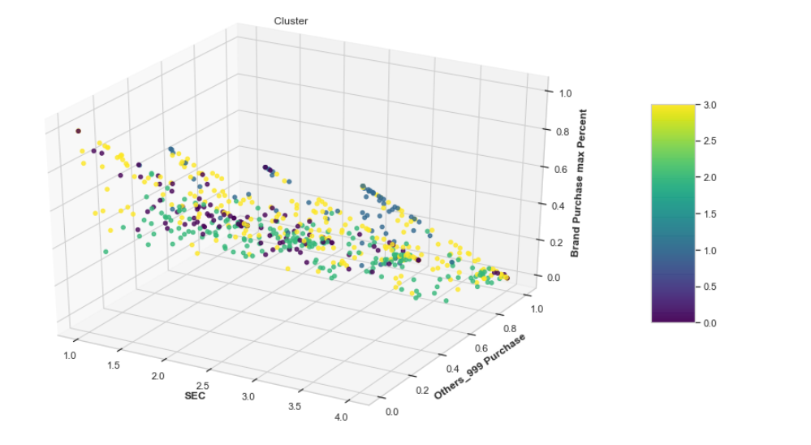
Cluster visuals

Slide 20
PaRT 2
Predictive model

Slide 21
Definition of success
1- Success = Cluster 0 , which represents loyal customer purchasing without promotion, low socioeconomic class with less education and less affluent.
0 ( failure) = Cluster 1, representing disloyal

Slide 22
STEPS
Using demographics data for Predictive modeling.
Data partition training set -60% , validation set 40%
Applied Logistic Regression with L2 Penalty and cv=5

Slide 23
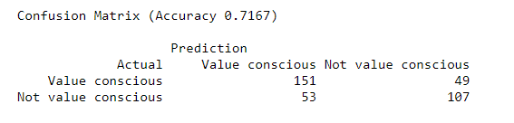
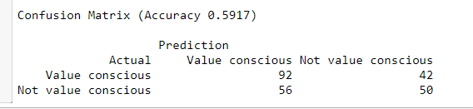
Evaluating Performance
Training Performance
Validation Performance

Slide 24
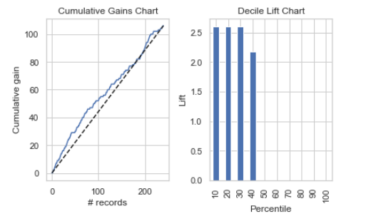
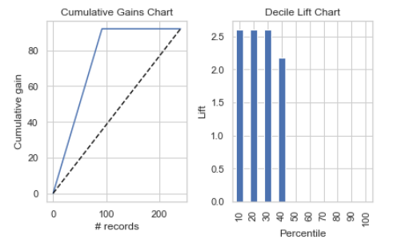
Evaluating Performance
Training Lift
Validation Lift

Slide 25
Conclusion/Recommendation
Training and validation decile lift is fairly same.
The model suggested that if we select 40% of high propensity households, this would have twice the chance of selection value conscious customers than naively selecting at random. So direct mailing these customers (which are brand loyal also) will be beneficial for CRISA
However the validation and training accuracy is much less, we can tree different classifier, or perform feature selection to implement it with best features

